Slide 1

PAKALO
Artificially Intelligent Cooking Assistant
FYP-II Final Evaluation
Abid Waqar i16-0229
Mashood Ur Rehman i16-0063 Supervisor
Nauraiz Mushtaq i16-0106 Dr. Omer Beg

Slide 2
Project Overview
1.
At a Glance

Slide 3
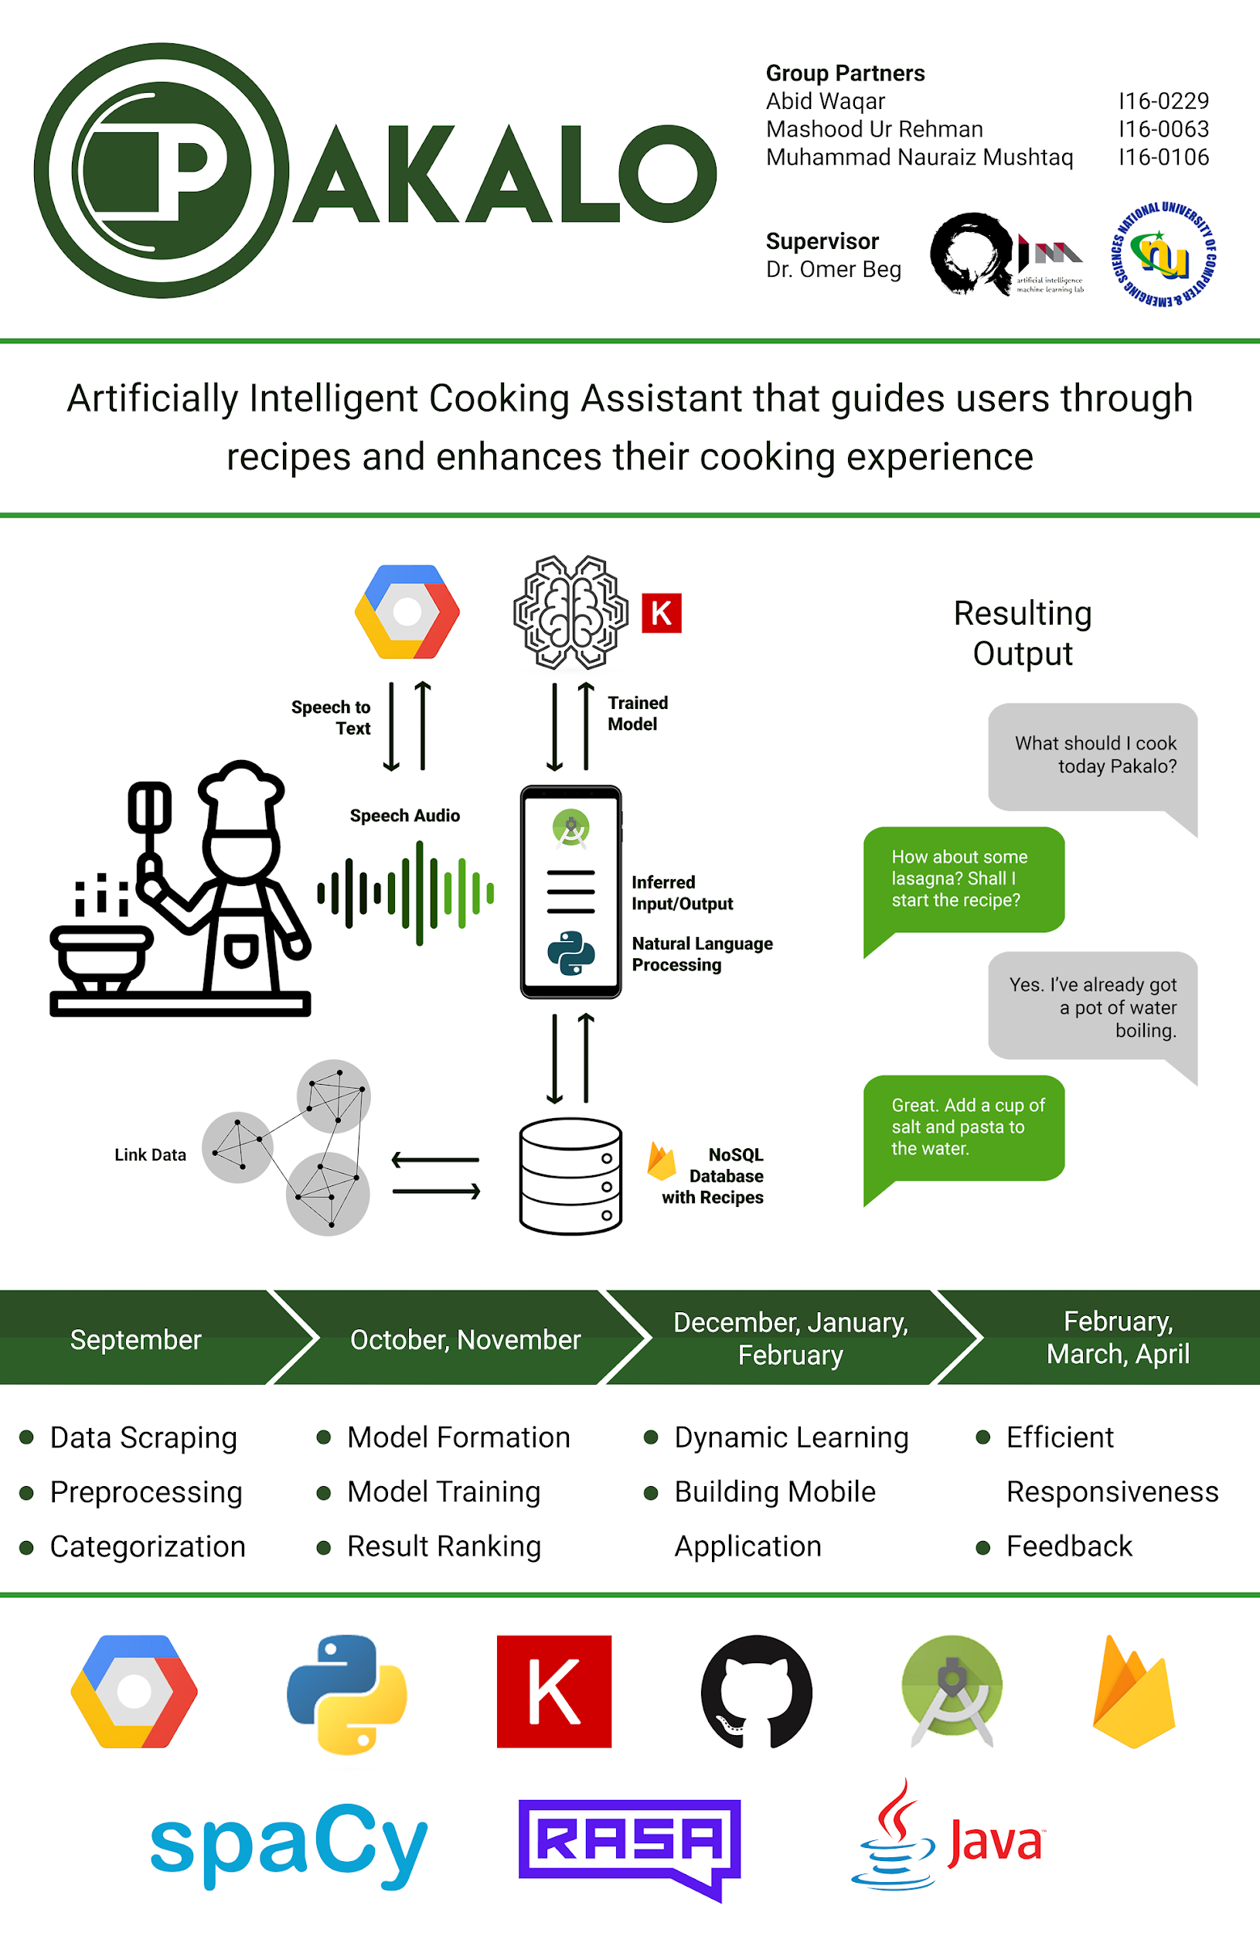
A Chatbot
An Assistant
A Social Platform

Slide 4
Goals and Objectives
2.
FYP-II (Iteration-4)

Slide 5
Iteration-3 Recap
3.

Slide 6
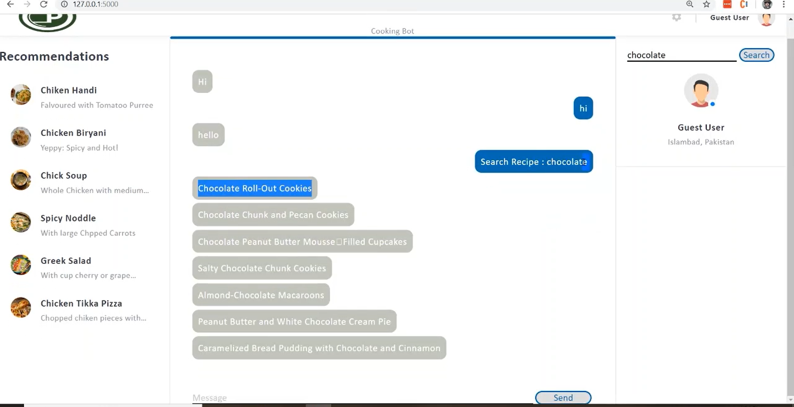
LSTM Bot

Slide 7
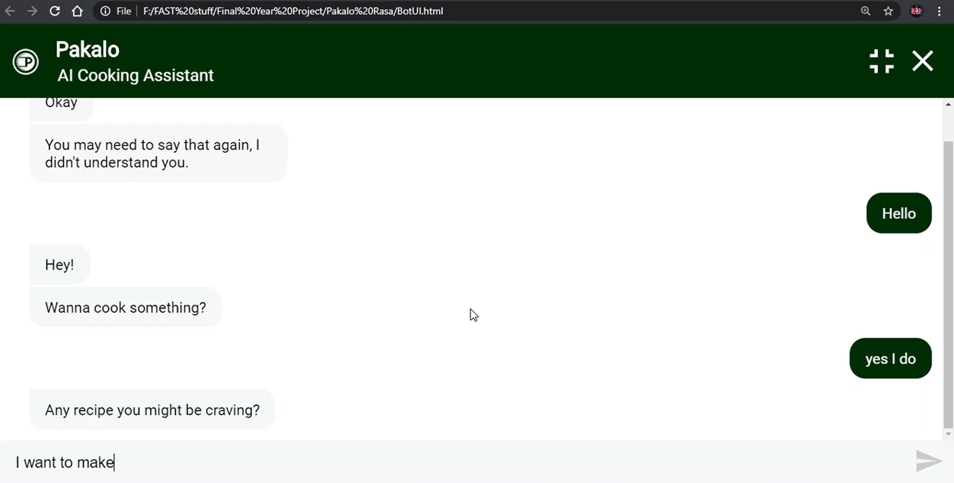
RASA Bot

Slide 8
FYP-II Use Cases
4.
Iteration 4 Work Done

Slide 9
Implemented Use Cases
Searching, Viewing and liking Recipe
Communication with Chatbot through speech to text and text to speech
Recommend Recipes based on history and liked recipes
Search ingredients as recipes that the user do not currently have.

Slide 10
Use Cases Not Implemented
Share and Upload Recipe
Substitute ingredients (Haram/Halal)

Slide 11
Problems Faced
5.
Implementation Details &

Slide 12
Implementation Details
App development using Android Studio
Integrating Rasa chatbot in android through API
Integrating speech to text and text to speech in android for communication with chatbot
Improved RASA chatbot model by implementing more intents and stories so that the chatbot can identify more intents of user.

Slide 13
Problems Faced
Firestore is a relatively new database so it does not have many data manipulation functions
RASA is a relatively new chatbot framework so the support for integration with android is really low
No library for Google speech to text api that records and send data in real time
Speech to text and text to speech thread management.

Slide 14
^{Detailed Demo}
6.

Slide 15
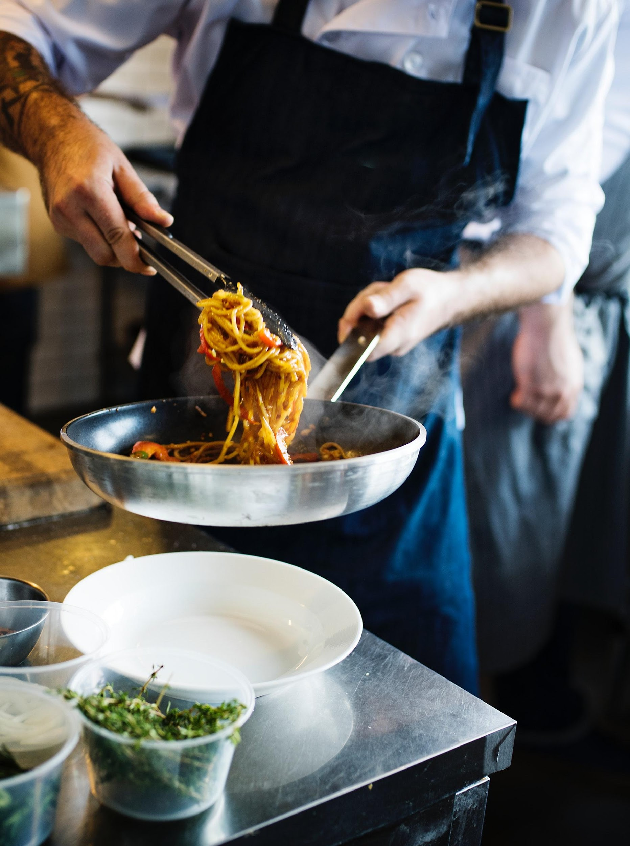
Thank you!
We would love to take any questions now.

Slide 16
Our Timeline
Iteration
One
Iteration Two
Iteration Three
Iteration Four
Data Scraping
Preprocessing
Categorization
September
Model Formation
Model Training
Result Ranking
October, November
Dynamic Learning
Building Mobile Application
December, January, February
Efficient Responsiveness, Feedback
February, March, April

Slide 17
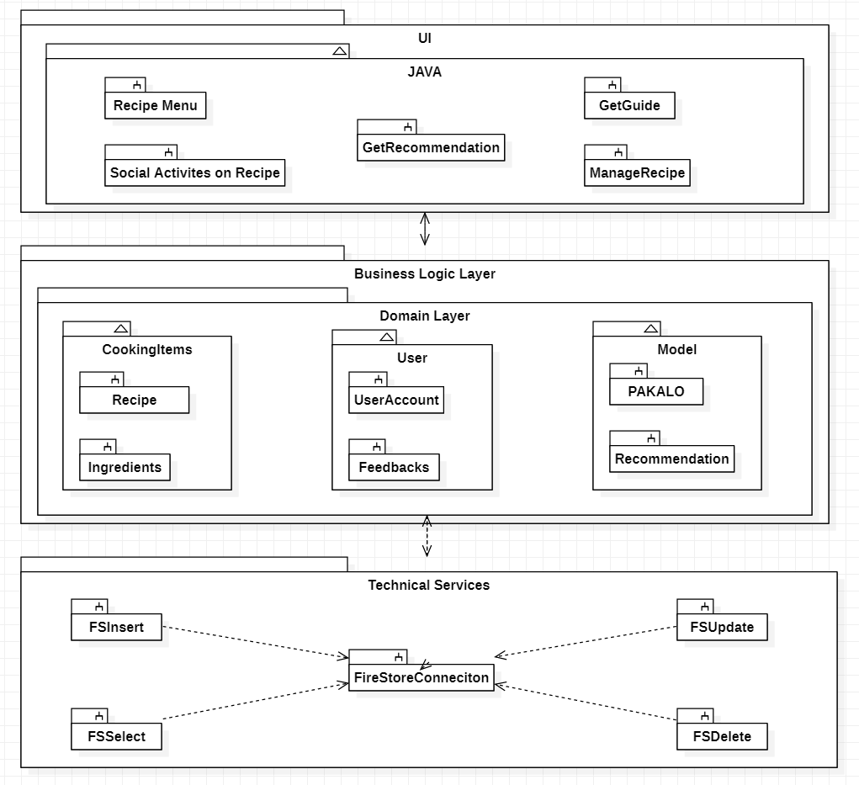

Slide 18
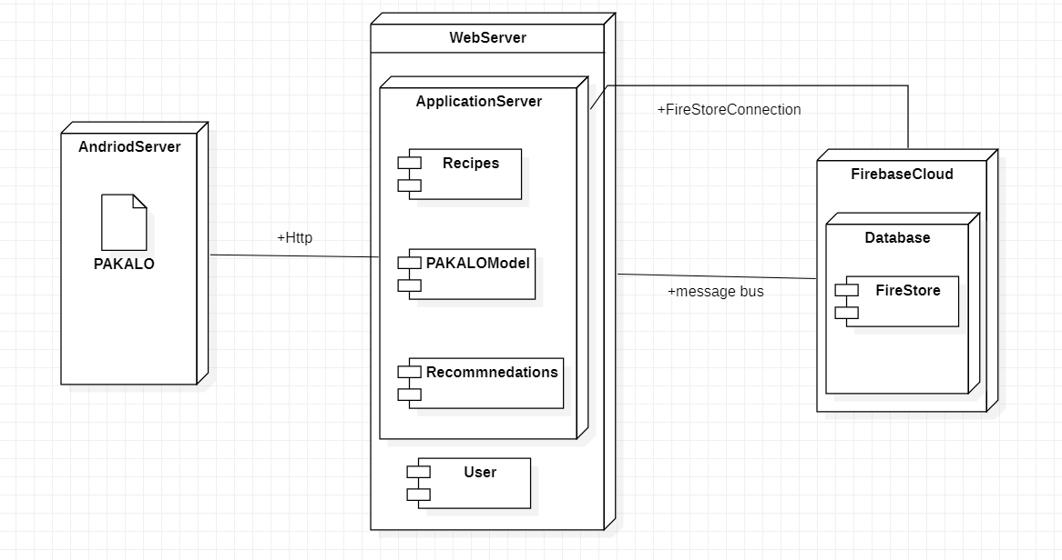

Slide 19
